Slide 1
Social Media Analytics & Web Mining Final Project: Nike
Brock DeVolder & Mitchell Hogan

Slide 2
Business Questions
How has Nike been using Twitter to reach customers?
Who is talking about Nike?
How many “unique” or different users are talking about Nike?
Are there popular people talking about Nike?
What kind of products does Nike advertise/sell?
Which of these products are the most popular?
Where in the world is Nike being talked about? Only the US?
What are some of the popular terms & keywords in tweets about Nike?
How does Nike interact with customers on Twitter?
What do reviews say about Nike?
What are popular words/bigrams in the reviews about Nike?

Slide 3
Approaches/Methods of Collection
Twitter API
3400+ tweets acquired from Nike’s Twitter account(s)
12,000 +Real-time tweets were acquired on May 1st 2019 from 3pm-12am

Slide 4
Approaches/Methods of Collection
Web scraping
100+ reviews from Influenster.com
Reviews were open-ended and covered all facets of the company.

Slide 5
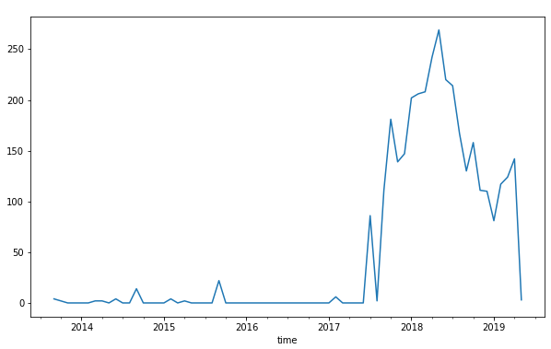
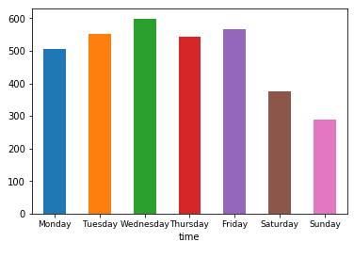
Nike’s Tweets
Nike began tweeting in 2013
Drastically increased usage in 2017
Tweets mostly on Wed & Fri
Drastic decrease in activity on weekends

Slide 6
Business Questions Answered
How has Nike been using Twitter to reach customers?
Nike often replies to customers Tweets directly.
How does Nike interact with customers on Twitter?
Customer Service & Advertising

Slide 7
Real-time Tweets about Nike
9477 unique users out of 12,009 tweets
A few popular hashtags are #Jordan, #fashion, #airmax
Out of the 12,009 tweets, 5884 were original & 6125 were retweets

Slide 8
Business Questions Answered
How many “unique” or different users are talking about Nike?
9477 unique user names
Where in the world is Nike being talked about? Only the US?
Tweets came from Cape Town, Zimbawe, Nigeria and other places from around the world
What are some of the popular terms & keywords in tweets about Nike?
Nike, air, max, Jordan, retro, etc.

Slide 9
Real-time Tweets about Nike
Nike store was the “most popular” user to Tweet about Nike
Would mainly be used for advertising and Customer Relations
Nike Store, HotNewHipHop & the Sacramento Kings are among those most “visible” on Twitter that tweet about Nike

Slide 10
Web Crawling with Selenium
Recent Reviews coming from Influenster.com
100 reviews, reviews had an average of 4.7 out of 5 star rating
Sentiment Analysis
Word Frequency/Bigrams

Slide 11
Sentiment Analysis (All Reviews)
Bing Liu Lexicon
According to Bing Liu Analysis, there are 88 positive reviews, 3 negative reviews, and 10 neutral reviews.

Slide 12
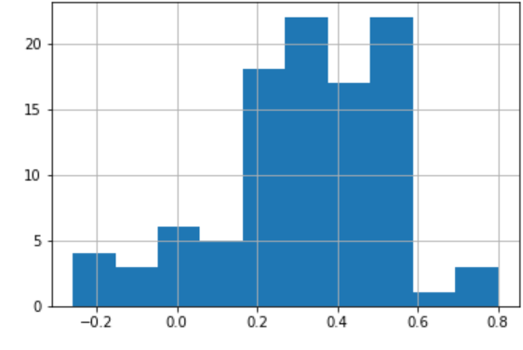
Sentiment Analysis (All Reviews)
Pattern Lexicon
The mean pattern sentiment score is .32, the minimum is -0.26, and the maximum is 0.80
Fairly Positive
Most pattern sentiment scores are between 0.175 and .58

Slide 13
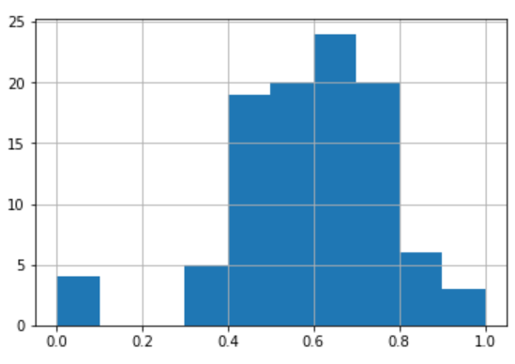
Sentiment Analysis (All Reviews)
Pattern Lexicon
The mean pattern subjectivity score is .59, the minimum is 0, and the maximum is 1.
Fairly subjective
Most subjectivity scores are between 0.40 and 0.80

Slide 14
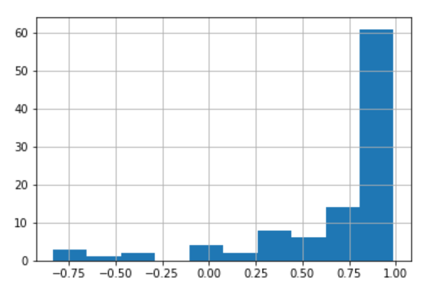
Sentiment Analysis (All Reviews)
Vader Sentiment
The mean vader sentiment score is 0.69, the minimum is -0.83, and the maximum is 0.99
Most reviews are between .75 and 1
Very positive reviews

Slide 15
Word Frequency Analysis (All Reviews)
Most Common words
Shoes, love, quality, comfortable, good, great, favorite
Popular Bigrams
Good quality, very comfortable, running shoes, high quality, last long

Slide 16
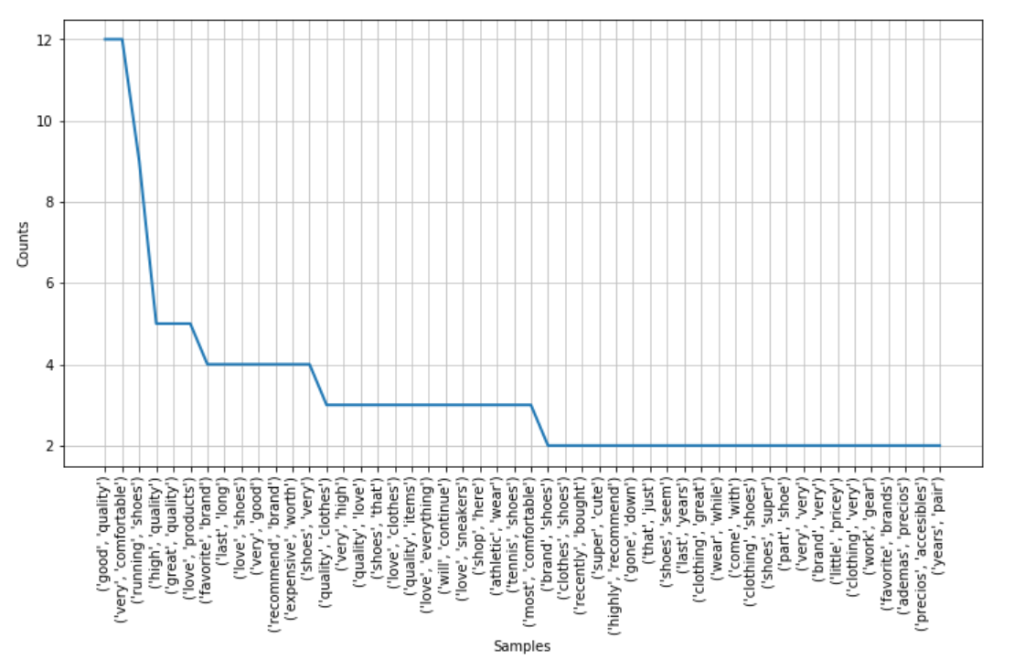
Word Frequency Analysis (Bigrams)

Slide 17
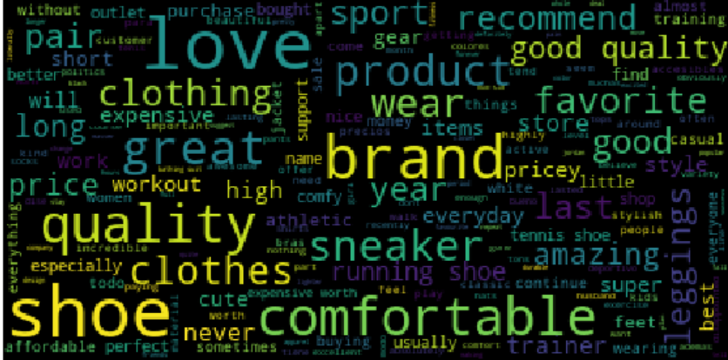
Word Frequency Analysis: Word Cloud

Slide 18
Overall Findings
Nike’s main use for Twitter is for Customer Interactions & Advertising
Nike offers a wide variety of products, but their shoes are still the most talked about
Reviews are very positive towards Nike; customers love their products
With a larger set of data, ranging over multiple sources, Nike could be able to better define what products give their customers the highest satisfaction, while also learning what they need to improve upon.

